Slide 1

Final Project Reducing Commute Time with
Machine Learning and Graph Analysis
Yu, Walter
CSCI E-63 Big Data Analytics
Harvard University Extension School
Prof. Zoran B. Djordjević

Slide 2
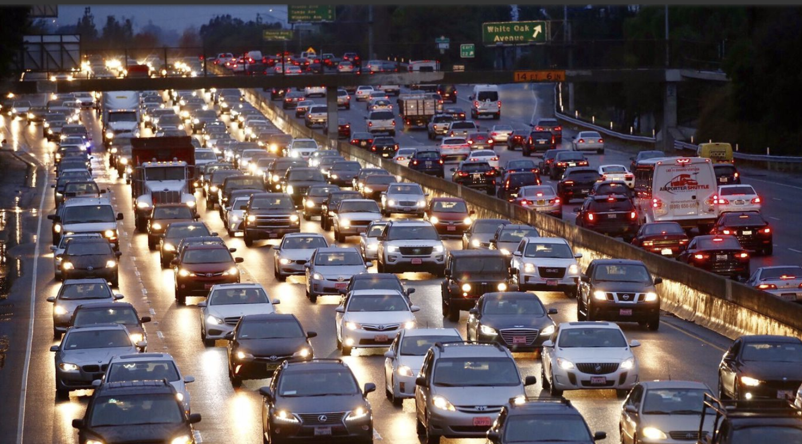
Introduction
Problem: Traffic congestion has negative impacts on roadways, worker productivity and the environment
Solution: Analyze U.S. commuter data with machine learning (ML) and graph analysis to help reduce commute times
Github: https://github.com/walteryu/e63-final
Photo Reference: https://lat.ms/2zJGUGZ

Slide 3


NHTS Dataset
National Household Transportation Survey (NHTS) dataset: https://nhts.ornl.gov/
National survey with ~1M records; ~700MB total
Project based on 2017 NHTS Data Challenge contest entry
ML Analysis: Algorithm selection and feature importance to identify key factors affecting commute times
Graph Analysis: Evaluate relationships between census division and total vehicle trips

Slide 4

Spark ML Pros/Cons
Spark ML: https://spark.apache.org/docs/1.2.2/ml-guide.html
Pros
Analyze large datasets quickly
Algorithm choices are sufficient for basic analysis
Supports data pipelines within Spark/Python environment
Cons
Algorithm choices may be limited for future analysis
Data visualization is limited (Matlibplot)

Slide 5

Spark ML Pros/Cons
GraphX: https://spark.apache.org/docs/1.2.2/graphx-programming-guide.html
Pros
Examine graph relationships between data
Supports dataframes; minimal integration required
Supports data pipelines within Spark/Python environment
Cons
Not as full-featured as Neo4J or similar graph databases
Data visualization is limited (Matlibplot)

Slide 6
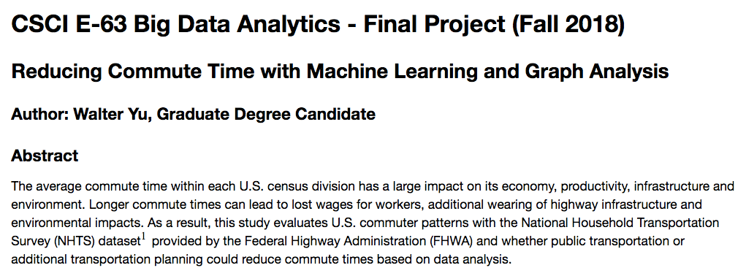
Data Analysis
Data cleaning, exploration and visualization
Calculate summary statistics
Analyze with ML and graph analysis
Document results in Jupyter Notebook

Slide 7
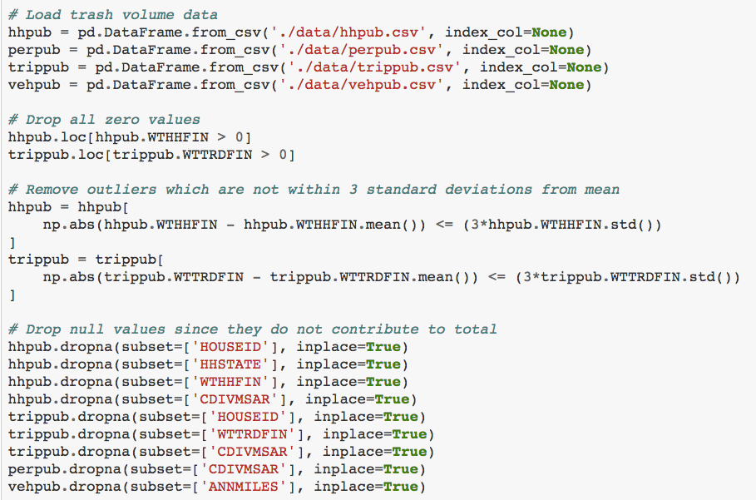
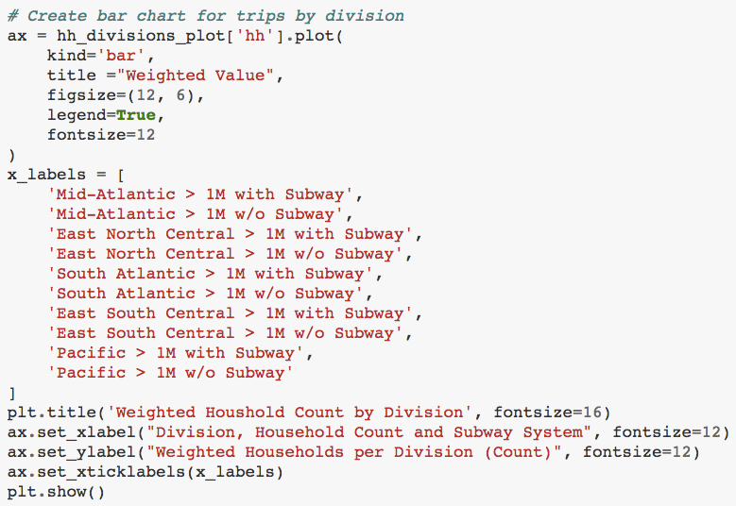
Data Analysis - Demo
<<< Code Example
Data Cleaning
Code Example >>>
Data Cleaning

Slide 8
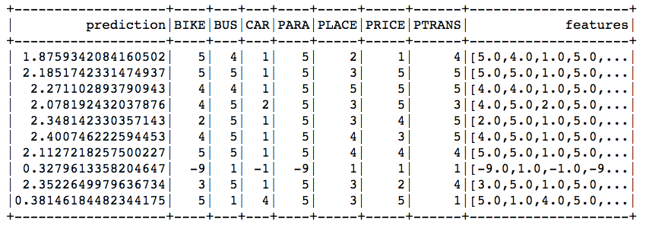
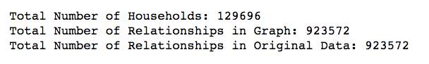
ML and Graph Analysis
Evaluate ML algorithm performance
Identify key factors with feature importance
Develop graph and calculate out-degree relationships
Example ML Output
Feature Importance:
Example Graph
Analysis Output:

Slide 9
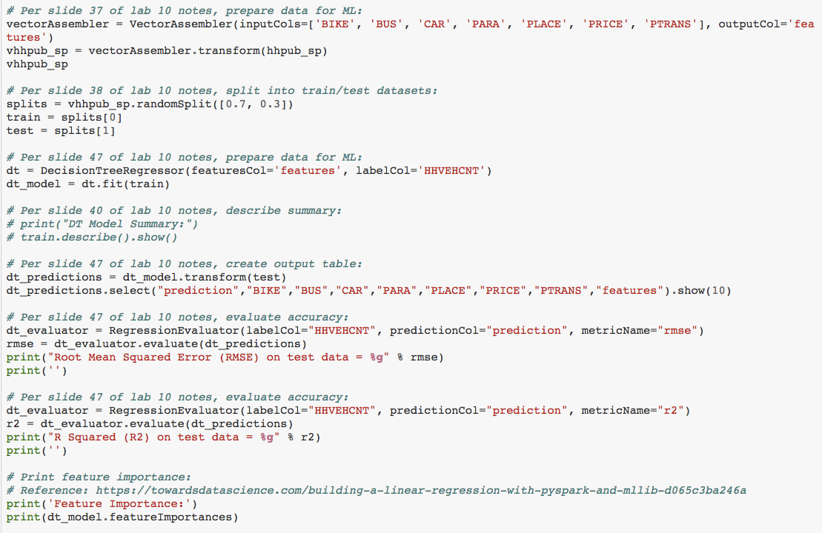
ML Algorithm Demo - Decision Tree

Slide 10
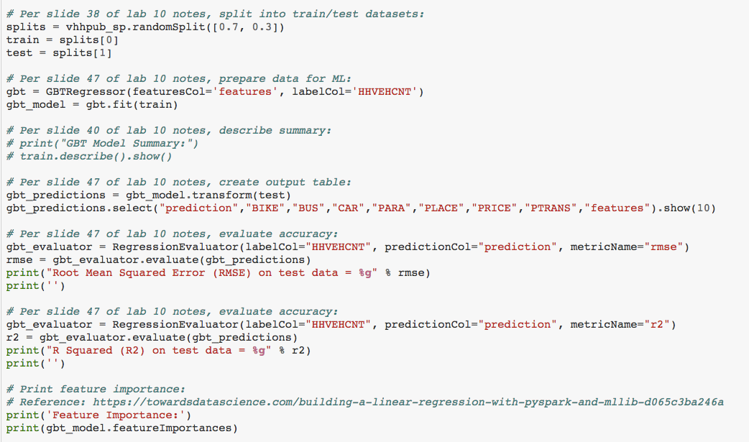
ML Algorithm Demo - Gradient Boosted Tree

Slide 11
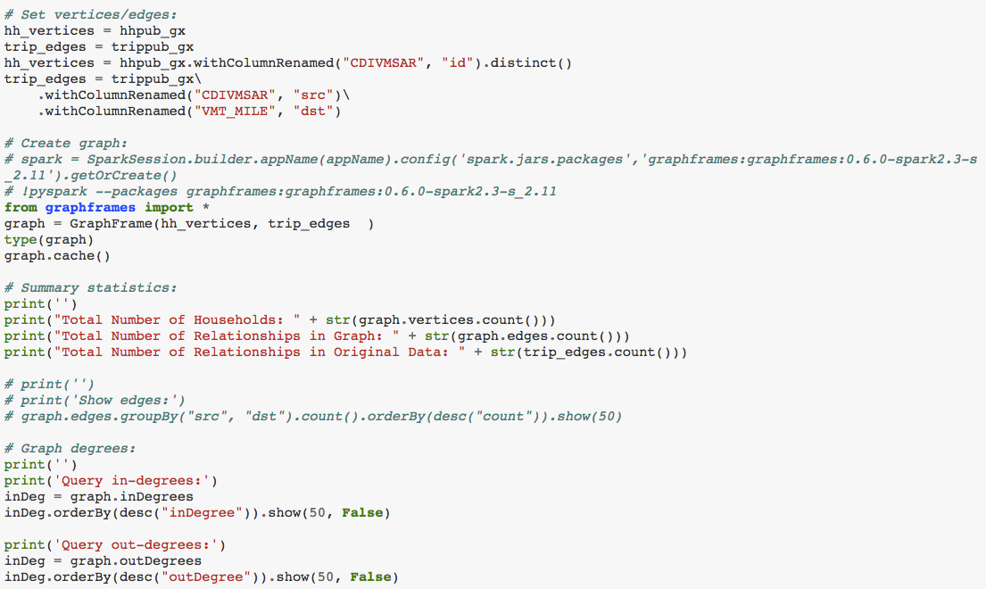
Graph Analysis Demo

Slide 12
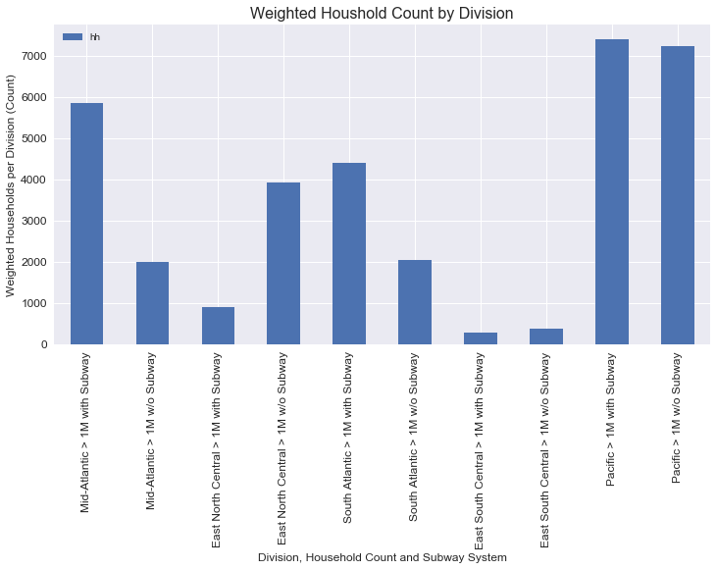
Household Data - Summary Statistics
Calculate household count by division
Separate by access to mass transit
Areas with mass transit typically have higher household count

Slide 13
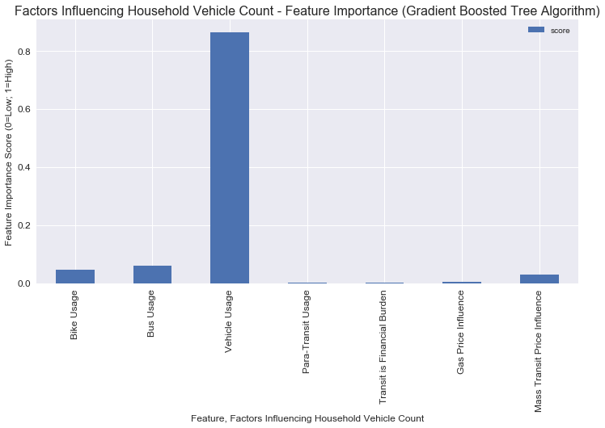
Household Data - Feature Importance
Vehicle usage most impacts total count
Other features have low significance
Mass transit feature has low significance with vehicle usage

Slide 14
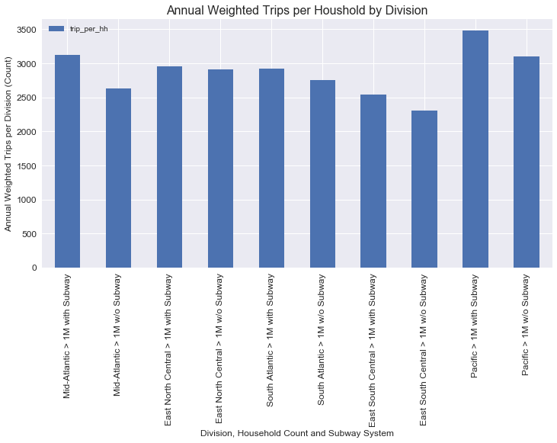
Trip Data - Summary Statistics
Calculate trip count by division
Separate by access to mass transit
Areas with mass transit typically have higher trip count

Slide 15
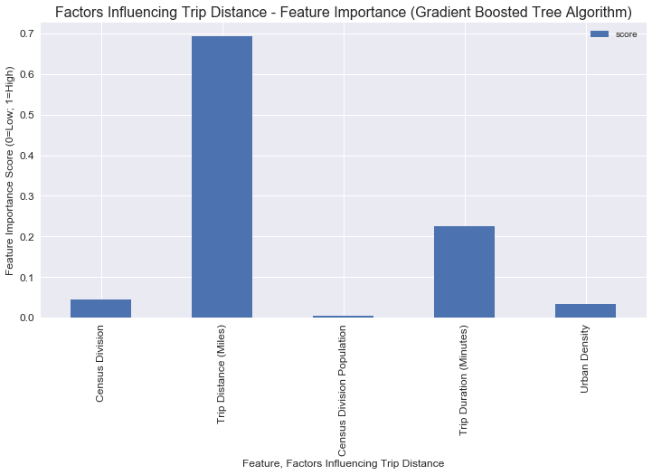
Trip Data - Feature Importance
Trip distance most impacts vehicle miles per trip
Trip duration is also significant feature
Other features have low significance

Slide 16
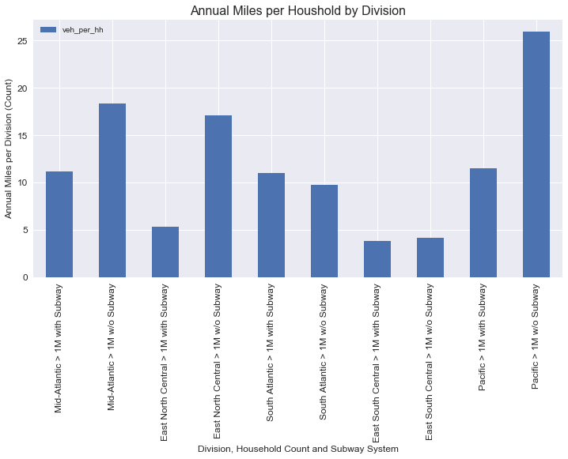
Annual Miles Driven - Summary Statistics
Calculate annual miles driven by division
Separate by access to mass transit
Areas without mass transit typically have higher miles driven

Slide 17
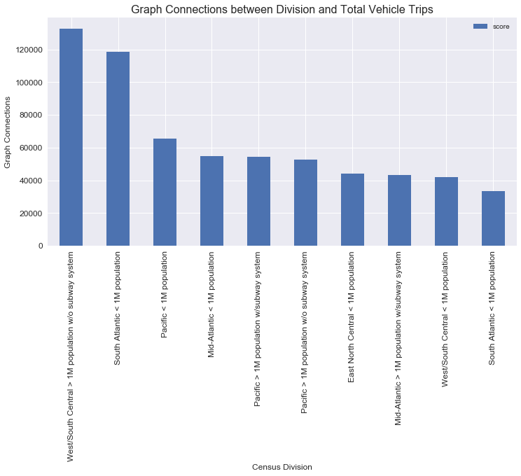
Graph Analysis - Out-Degree Relationship Count
Calculate out-degree relationships between division and total trips
Areas without mass transit and lower population

Slide 18
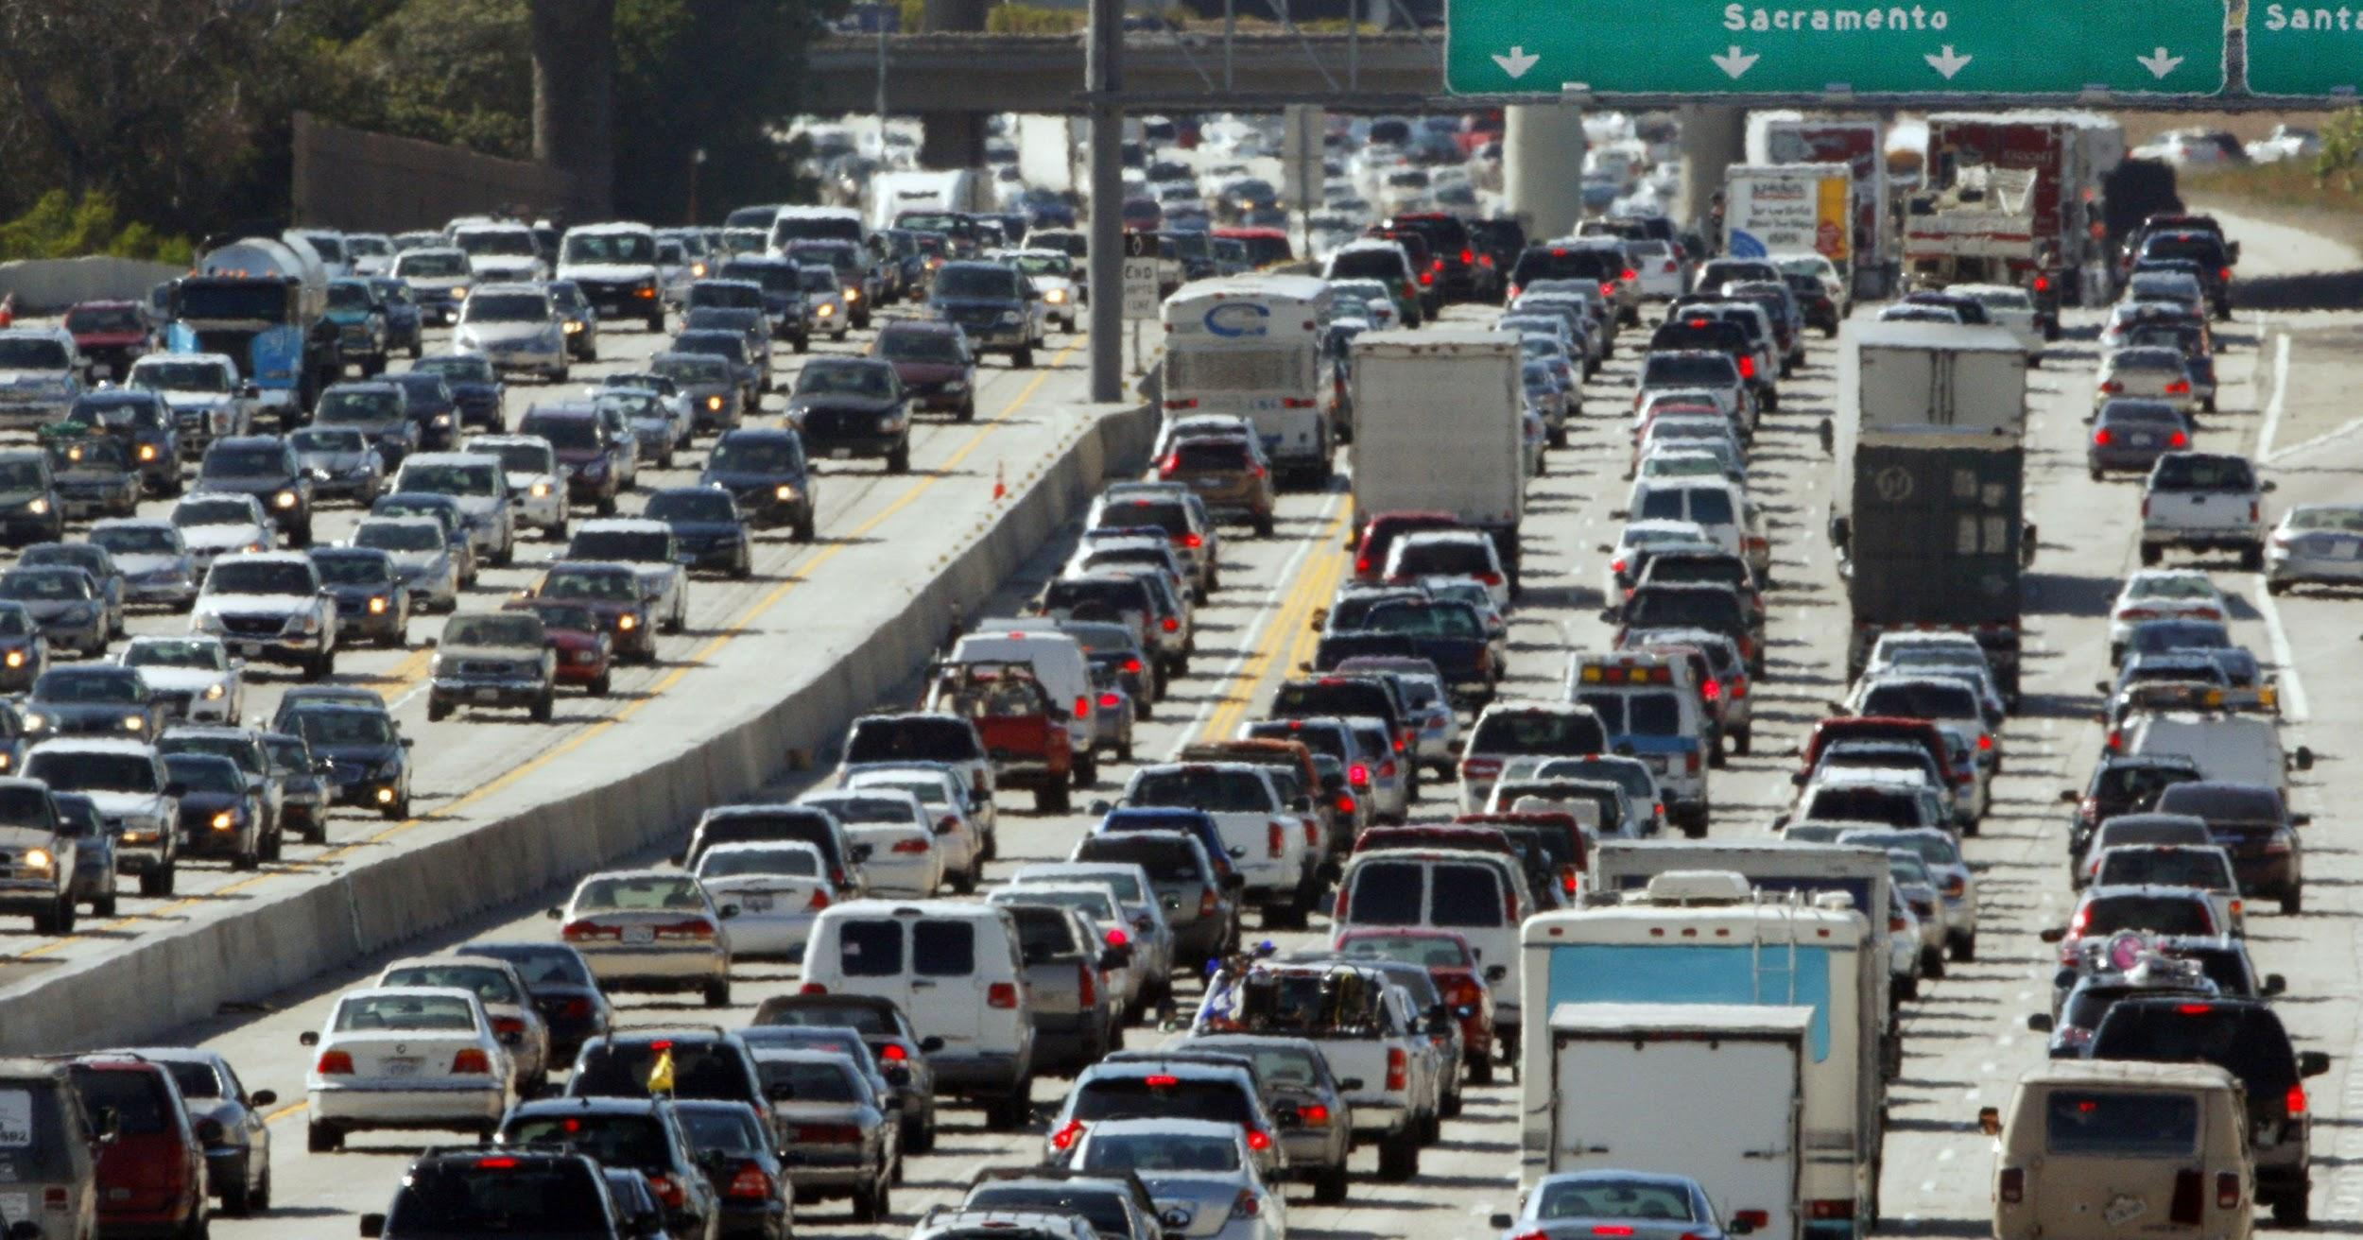
Observations
Photo Reference: http://bit.ly/2DZ2avA
Mass transit does not appear to directly influence driving behavior; however, trip distance/length has high significance
Urban areas have higher population so appear to have higher total trips but shorter distances; rural areas have lower population so have lower total trips but longer distances
Households with higher income appear to have higher vehicle count and usage; trip destination also has significance

Slide 19
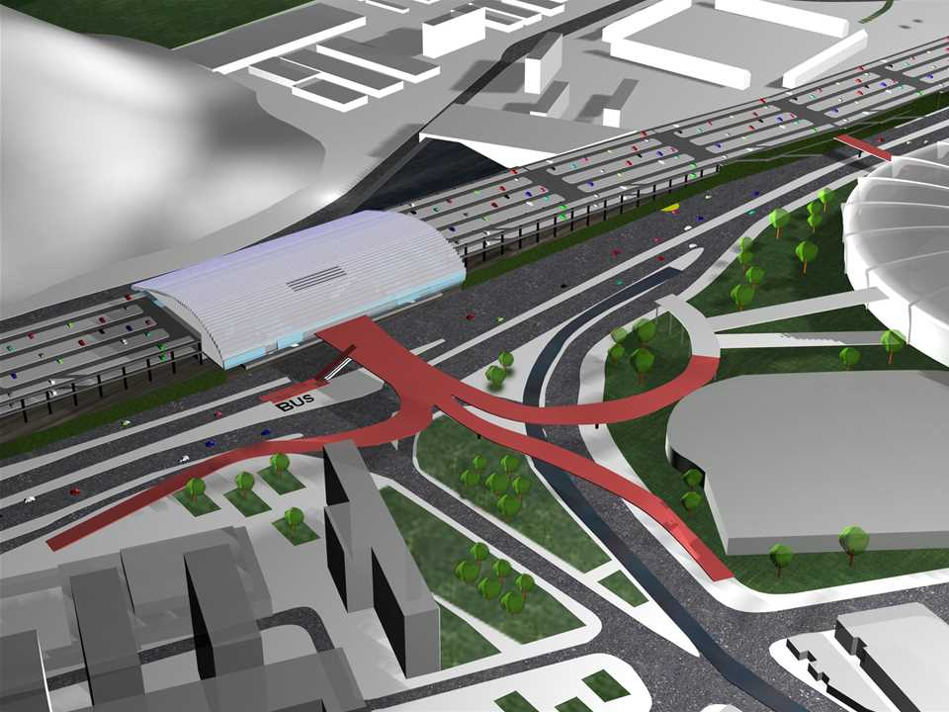
Recommendations
Photo Reference: http://bit.ly/2E2N7Rh
Public education is recommended to raise awareness
Results may be useful to urban planners
Encourage households to take action by living near urban areas instead of relying on urban planning to solve problem
Mass transit alone is unlikely to reduce vehicle usage; actions to change driving behavior are recommended

Slide 20
YouTube URLs, Last Page
Two minute (short):
15 minutes (long):

